Slide 1
Dynamic Office Map
Presented by Fsociety

Slide 2
Contents
Motivation
Architecture
Demo
Improvements
Q&A

Slide 3
Motivation
Let’s help Elena find her colleague’s desk.
Let’s help ITS to count inventory easier.
You can let your colleagues know that you’re in the break room.
You can tell everybody that you’re in a meeting room, and have been there the entire day with Oana&Andreea at some softskills training.

Slide 4
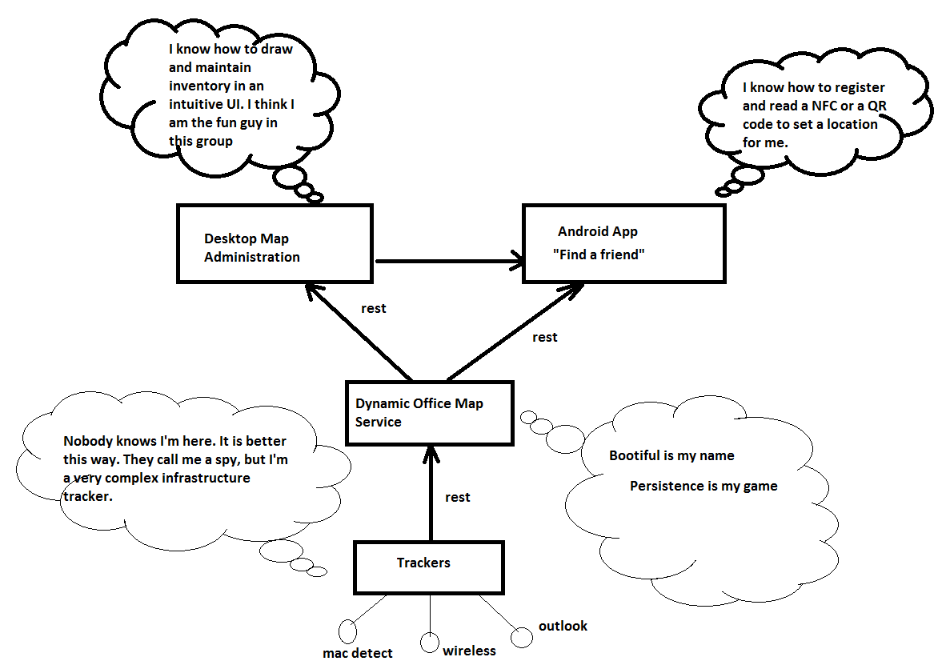
Architecture:: High Level Overview

Slide 5
Architecture:: Technology Stack
Spring Boot
Mysql + flyway (for DB versioning)
Spring Data JPA
Angular JS
Bootstrap
FabricJS
Android and Android Annotations
Of course, a cup of Java

Slide 6
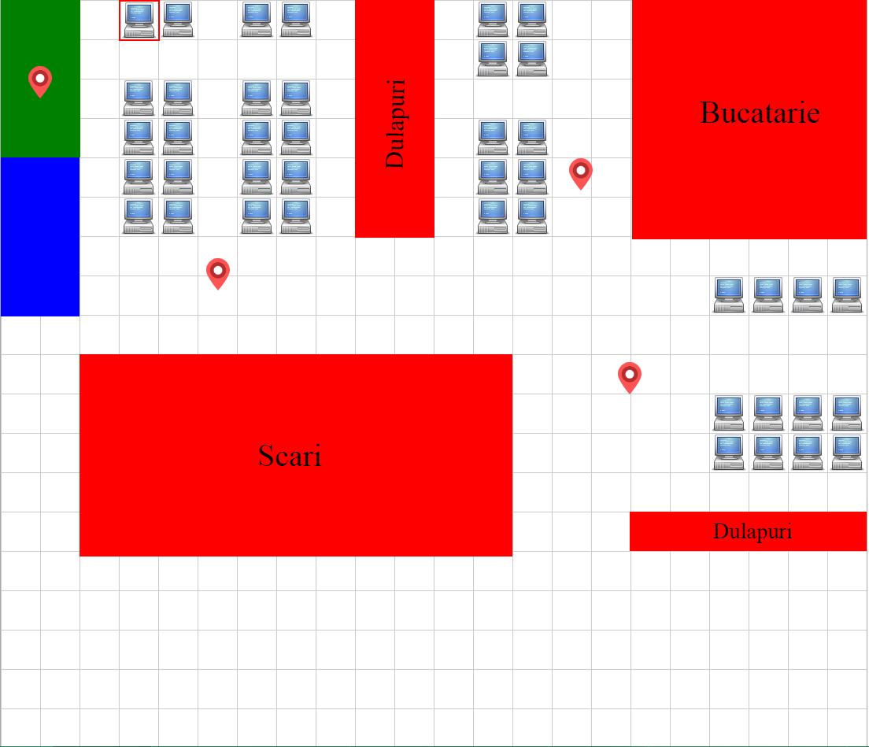
Live Demo
Map created using our app. It’s interactive!
Fsociety

Slide 7
Improvements
Add security for a production deployment
Extend concepts and introduce “Assets” (one asset can be a “Desk” or something else that one might need to add to inventory).
Develop a tracker with more sources: Outlook Rooms (and meetings),
WiFi triangulation, face detection etc.

Slide 8
Q & A
Want to see the app closer?

